Slide 1

Enhancing Low Light Images Using Convolutional Neural Network to Detect Emotion
Omar Ali, Izaiah Benavides, Charith Kondapally, Mateo Nuñez

Slide 2

Goals
Detecting human emotions
Improving low-light images
Enhancing a CNN performance

Slide 3
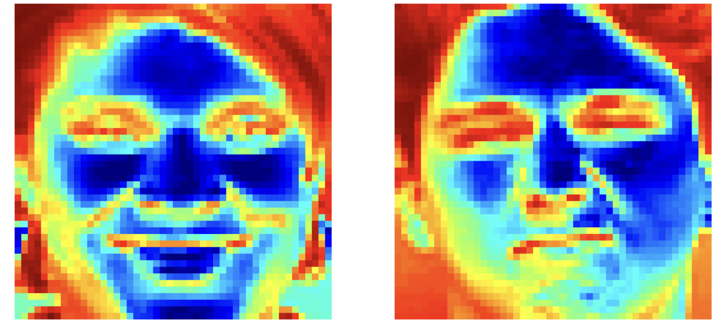
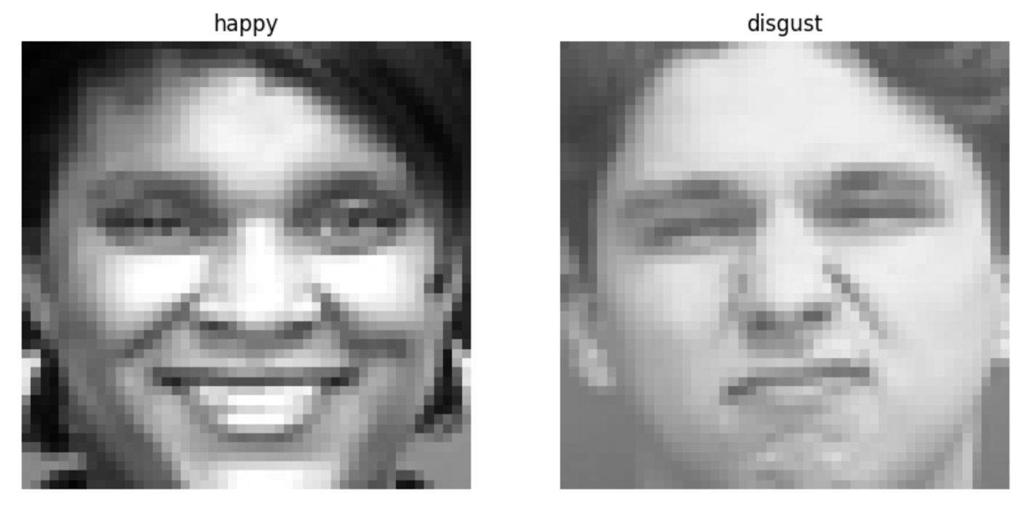
High-level Design
Adjustments in brightness
Multiple Convolutional Layers extracted detailed
features
Max-pooling layers reduced the dimensionality
Batch normalization accelerates efficiency
Grayscale normalizes lighting variations
Histogram equalization enhances the contrast of images
Image is converted to RGB
Two models: one trained on raw images, and the other trained on enhanced images

Slide 4
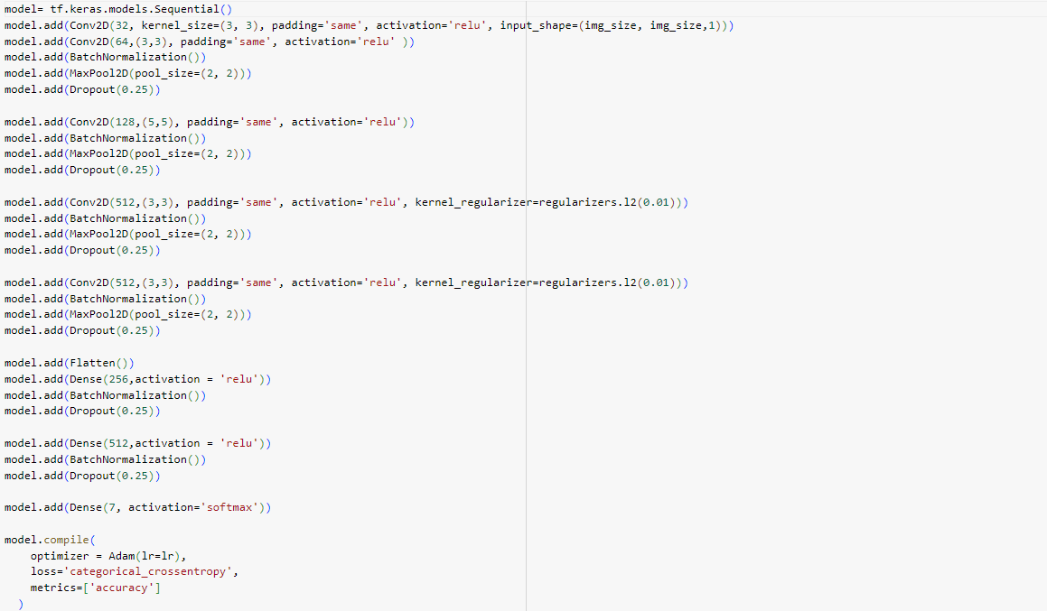
Control Model

Slide 5
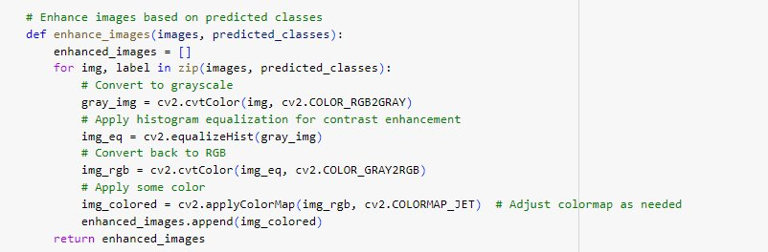
Image Enhancement

Slide 6
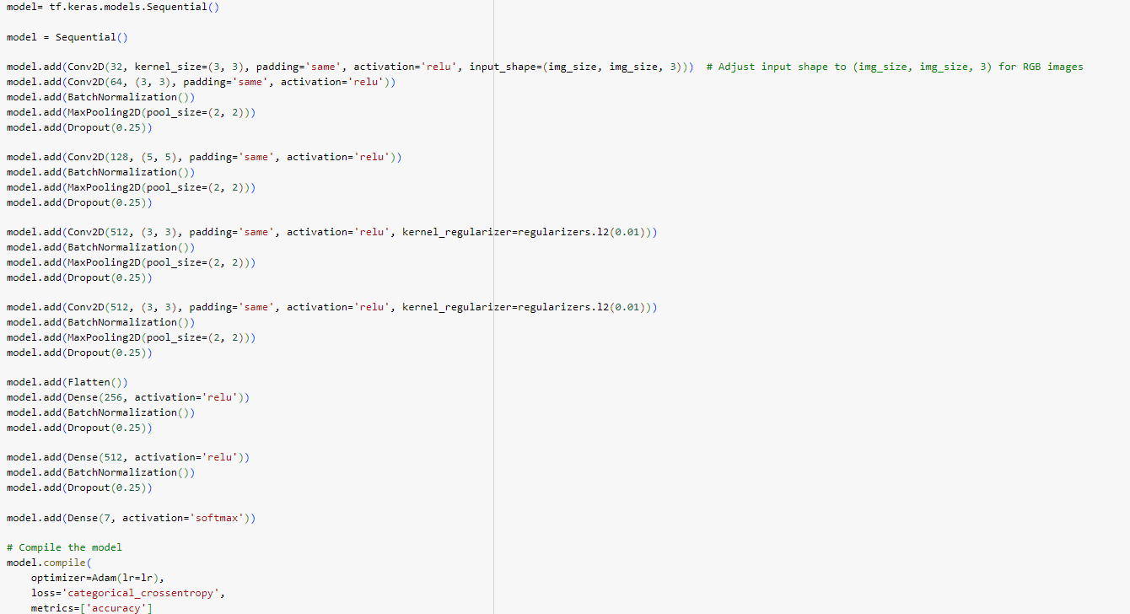
Experimental Model

Slide 7

Tools and Algorithms
Python: TensorFlow, Keras, NumPy, and cv2, Matplotlib
Horizontal flipping and random transformations were used as image augmentation techniques
Created an enhancing image function
Adam Optimizer
Categorical class entropy
CK+ Dataset
788 training images + 193 validation images = 981 images

Slide 8
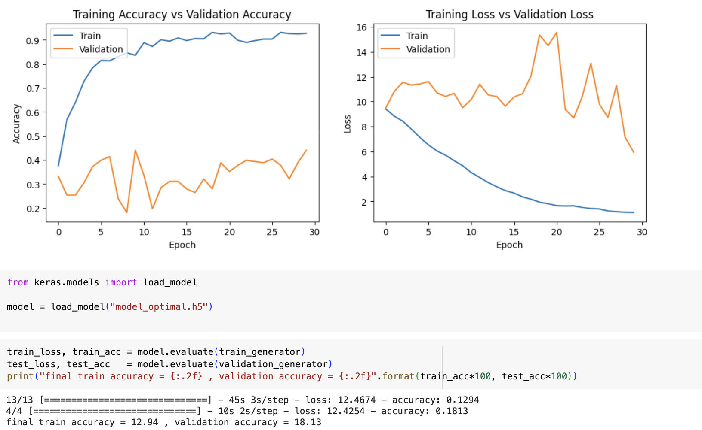
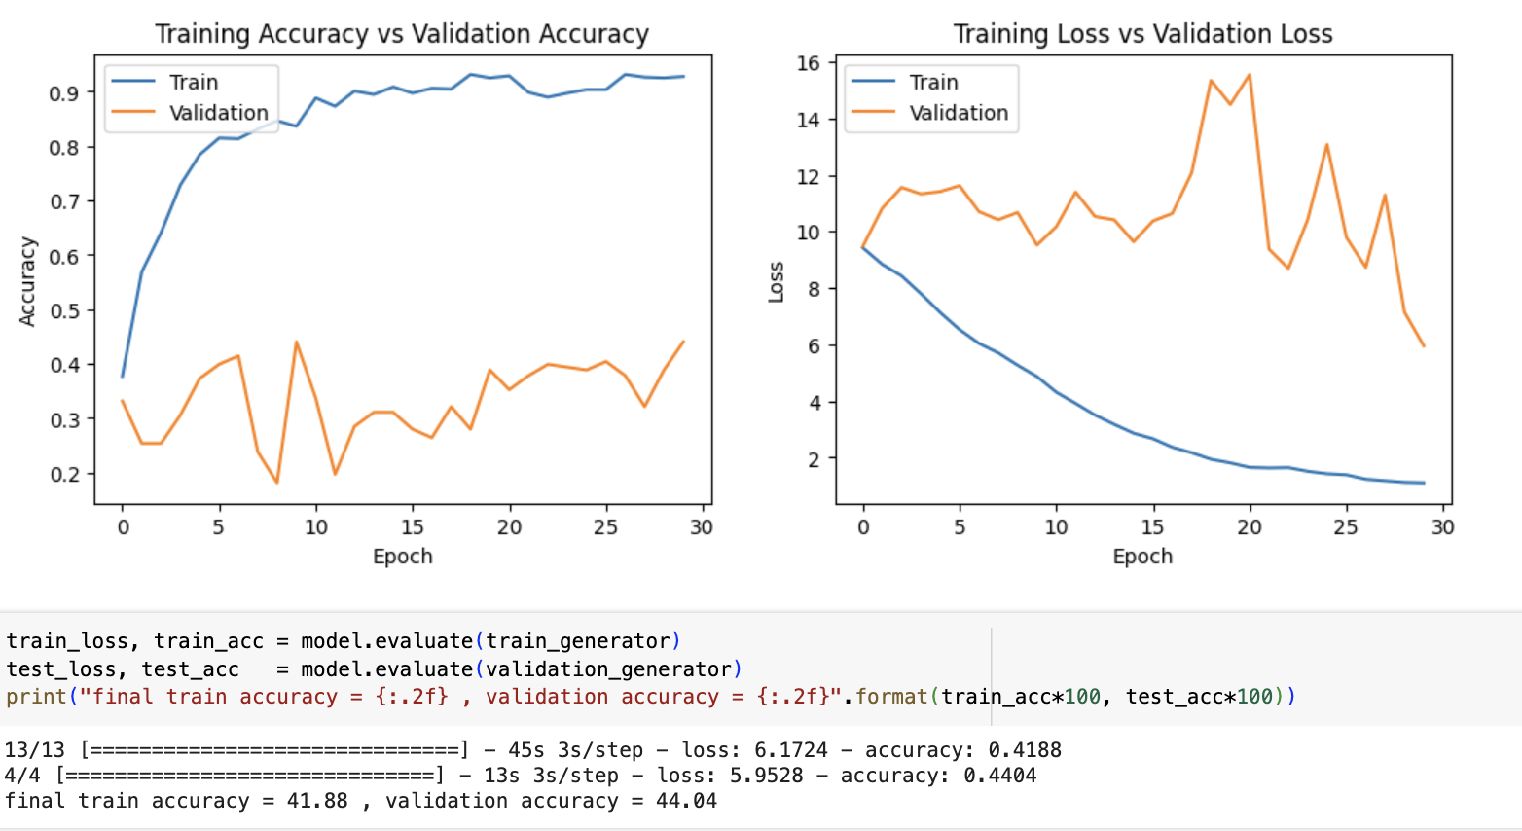
Trial 1 Results
30 epochs were implemented for both models
Enhanced preprocessing of images performed better
How to improve the accuracy?

Slide 9
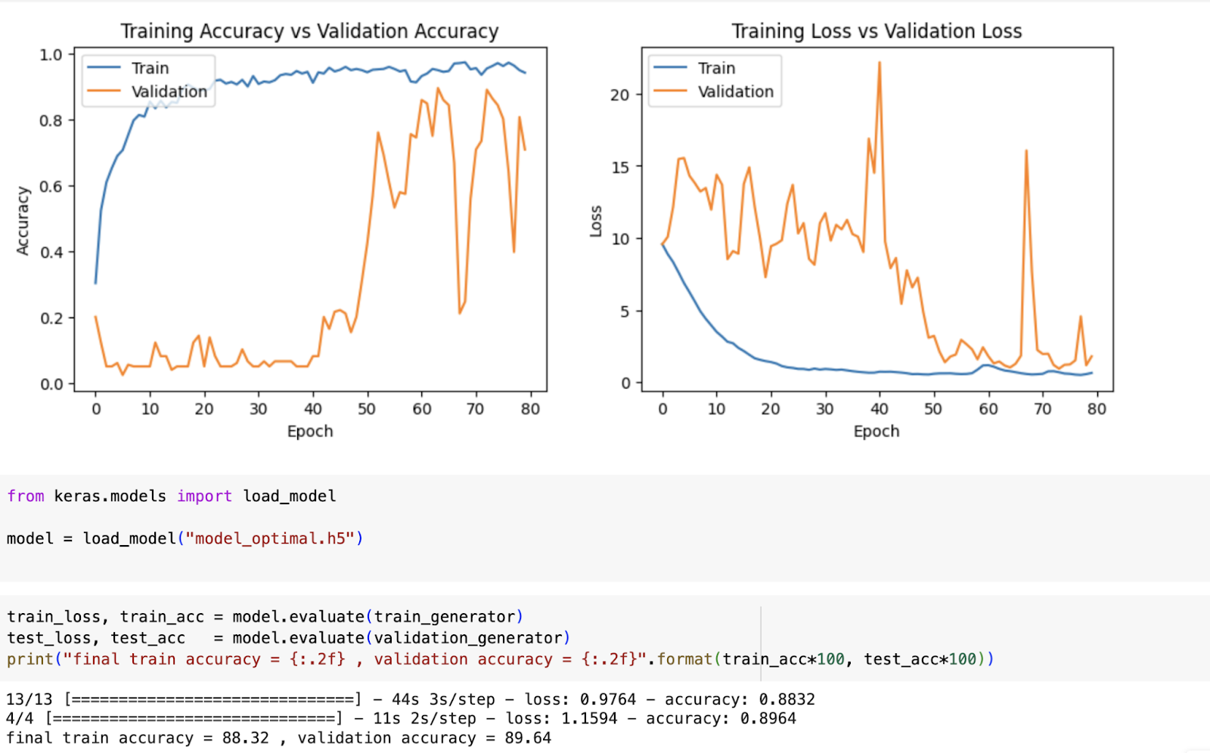
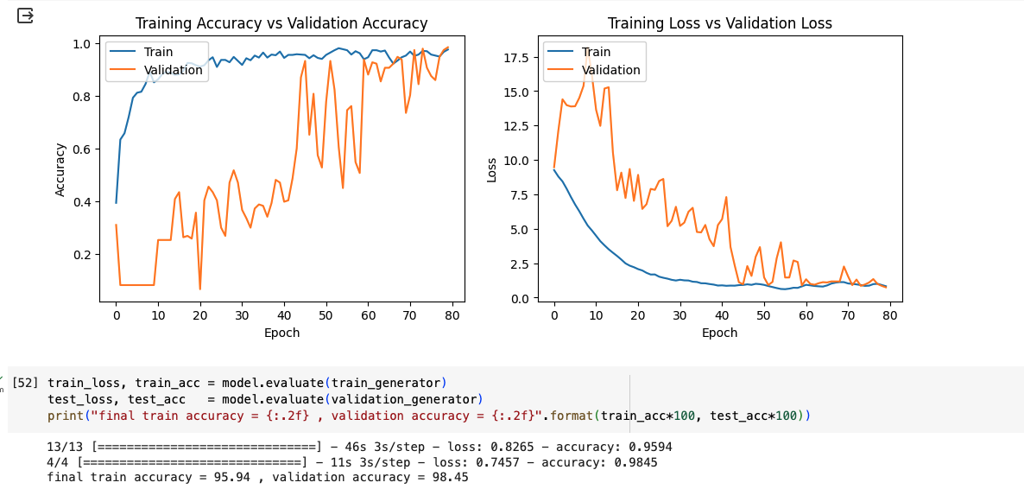
Trial 2 Results
Because of the poor results more epochs were added for a total of 80
The 80 epochs were applied to both the regular images and enhanced images models
Our enhancement techniques improve training and validation accuracy

Slide 10
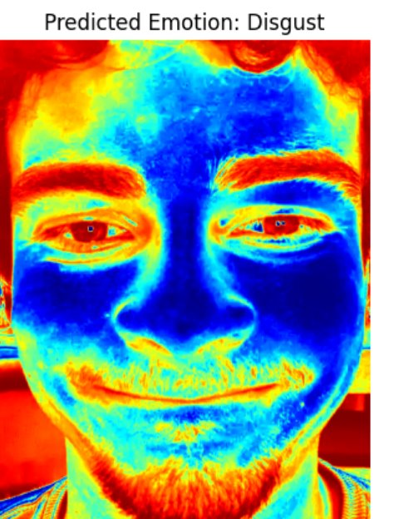
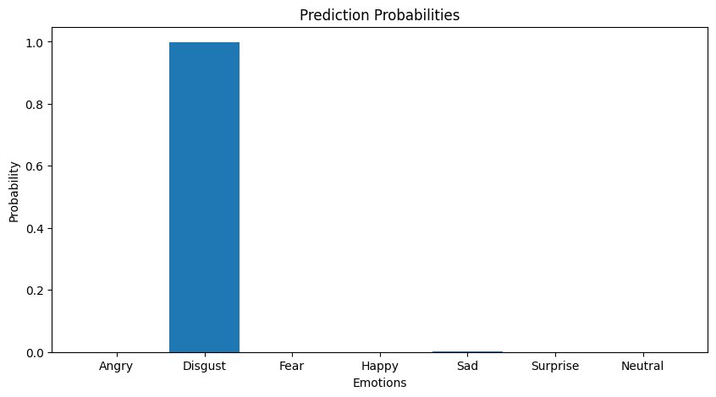
Demo - Izaiah’s Face

Slide 11
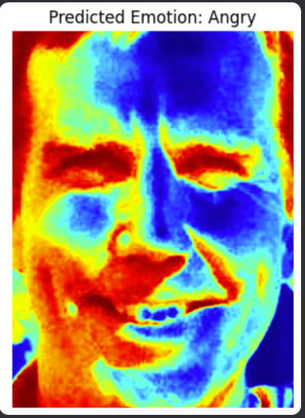
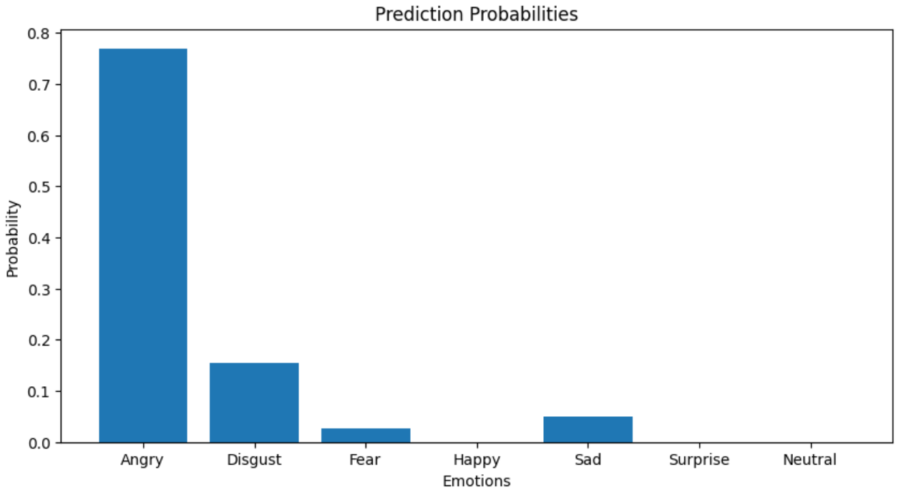
Demo - Dr. Ruby’s Face

Slide 12
Future Work
Diversify the dataset
Focus on complex combination of features
Expand the dataset
Use more refining image techniques
Enhance clarity
Reduce noise
Reduce sharpness
Use dynamic range adjustments
Incorporate contextual data
Process data in real-time

